Slide 1
AWT
Abstract Window Toolkit

Slide 2
Steps:
Import awt or swing package.
Create a window(frame) object.
Set the layout for the frame.
Create component controls(button,chechbox,scrollbar etc) required for your application.
Add the component objects to the frame using add() method.
Write the event handling mechanism for the created components.

Slide 3
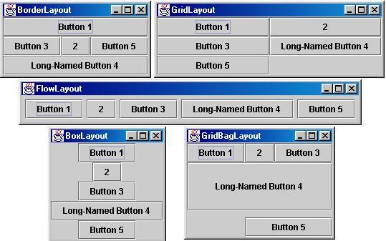


Slide 4
Graphical User Interface
GUI: Graphical User Interface
  Windowing interface that handles user input and output
Abstract Windowing Toolkit (AWT)
  Java's original collection of GUI packages
  Relies on underlying OS Native User Interface
Swing Toolkit
  Provides a uniform look and feel and consistent behavior across all platforms
Most GUI applications use classes from both of these toolkits
  learn how to employ Java's AWT/Swing framework to design graphical user interfaces

Slide 5
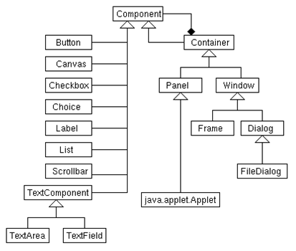
AWT Class Hierarchy

Slide 6
Container
It is a subclass of Component,but abstract.
It provides additional methods to nest the other components and create a component hierarchy.
Also responsible for laying out components through the use of Layout managers.
It defines methods such as add(Component c),remove(Component c),getLayout(),setLayout(),in addition to inherited Component methods.
Example for Containers are Applet,Panel,Frame,Window…..

Slide 7
Panel
Concrete Subclass of container.
Panel is the superclass for Applet.
It is a window without titlebar,menubar,border bar.
An applet when run as part of browser do not have above borders due to this;because it is subclass of Panel.
Default layout for panel is Flowlayout
This can be part of another container.
Components can be added using add() method.

Slide 8
Window
The Window class creates a top-level window.
A top-level window is not contained within any other object; it sits directly on the desktop.
This is also a container.
No borders,menubar
Default layout is BorderLayout

Slide 9
Frame class
It is a subclass of Window and has a title bar, menu bar, borders, and resizing corners.
Frame(),Frame(String Title)
There are several methods which allow you to create and work with frame.They are
  public String getTitle() //get title
  Public void setTitle(String title)
  public void setVisible(boolean b)
  public Dimension getSize()
  public void setSize(int width, int height)
  public Rectangle getBounds()

Slide 10
Closing Frame Window
Whenever you need to make a frame disappear when close[x] is clicked,you need to catch windowEvents and in method windowClosing.

Slide 11
Creating a Frame Window from an Applet
import java.awt.*;
import java.awt.event.*;
import java.applet.*;
public class AppletFrame extends Applet {
Frame f;
String msg;
public void init() {
f = new Frame("A Frame Window");
f.setSize(250, 250);
f.setVisible(true);
MyWindowAdapter wind= new MyWindowAdapter();
f.addWindowListener(wind);
}
public void paint(Graphics g) {
g.drawString(msg, 10, 20);
}
class MyWindowAdapter extends WindowAdapter {
public void windowClosing(WindowEvent we) {
msg="window closed";
f.setVisible(false);
}
}
}

Slide 12
Creating your own frame
class SampleFrame extends Frame {
SampleFrame(String title) {
super(title);
// create an object to handle window events
MyWindowAdapter adapter = new MyWindowAdapter();
// register it to receive those events
this.addWindowListener(adapter);
}
public void paint(Graphics g) {
g.drawString("This is in frame window", 10, 40);
}
}
Objects of SampleFrame can be created.
Ex: Sample frame =new SampleFrame(“A sample window”);

Slide 13
AWT application(non applet)-mouse & window
import java.awt.*;
import java.awt.event.*;
//creating your own frame
class HandlingDemo extends Frame{
String msg=" ";
HandlingDemo(){
MouseHandler handle=new MouseHandler();
WindowHandler handle1=new WindowHandler();
this.addMouseListener(handle);
this.addWindowListener(handle1);
}
public void paint(Graphics g)
{
g.drawString(msg,100,100);
}

Slide 14
Contd…..
class MouseHandler extends MouseAdapter{
public void mousePressed(MouseEvent me) {
msg="mouse pressed";
repaint();
}
}
class MyWindowAdapter extends WindowAdapter {
public void windowClosing(WindowEvent we) {
msg="window closed";
f.setVisible(false);
}
}
public static void main(String args[]) {
HandlingDemo appwin = new HandlingDemo();
appwin.setSize(new Dimension(300, 200));
appwin.setTitle("An AWT-Based Application");
appwin.setVisible(true);
}
}

Slide 15
Exploring Text and Graphics
Study from textbook Graphics,Font,FontMatrix,Color class usage examples.Some usage of graphics and font ,fontmatrics class is made in Applet examples before.See the rest example.

Slide 16
Contd…..
Drawing Lines
void drawLine(int startX, int startY, int endX, int endY)
Drawing Rectangles
void drawRect(int top, int left, int width, int height)
void fillRect(int top, int left, int width, int height)
Drawing Ellipses and Circles
void drawOval(int top, int left, int width, int height)
void fillOval(int top, int left, int width, int height)
Drawing Arcs
void drawArc(int top, int left, int width, int height, int startAngle,int sweepAngle)
void fillArc(int top, int left, int width, int height, int startAngle, int sweepAngle)
Drawing Polygons
void drawPolygon(int x[ ], int y[ ], int numPoints)
void fillPolygon(int x[ ], int y[ ], int numPoints)
  int xpoints[] = {30, 200, 30, 200, 30};
  int ypoints[] = {30, 30, 200, 200, 30};
  int num = 5;
  g.drawPolygon(xpoints, ypoints, num);

Slide 17
Color class
Java supports color in a portable, device-independent fashion.
Color is encapsulated by the Color class.
Color defines several constants (for example, Color.black) to specify a number of common colors.
You can also create your own colors, using one of the color constructors.
  Color(int red, int green, int blue)
  Color(float red, float green, float blue)
Ex:
Color c=new Color(255, 100, 100);
setForeground(c);
setBackground(c);

Slide 18
AWT Controls
The AWT supports the following types of controls:
  ■ Labels
  ■ Push buttons
  ■ Check boxes
  ■ Choice lists
  ■ Lists
  ■ Scroll bars
  ■ Text editing
Layout managers
Using insets,bounds etc

Slide 19
Adding and removing Controls
Create control using constructor
Add it to container(applet,frame,panel) using add and remove methods defined in container.
Component add(Component c);
Returns a reference to added control.The added component is made visible whenever the parent window is visible
void Remove(Component c)
Removes the component from container
void removeAll()
Response of the controls
Other than label all controls catch events,so u need to do registering and providing the implementation for the handling of event

Slide 20
Label
A Label component is a single line of text.
The text cannot be edited by the user, although it can be changed by your program.
A Label class has two main constructors:Label(String s) and Label(String s,int how);
  Label name = new Label(“John"); //This Label constructor displays the given text.
  Label name = new Label(“John", Label.CENTER); //creates a label whose text is centered in the available space.
getText() and setText(): Sets and gets the text for the label.
name.setText(“Harry");

Slide 21

Example: Label
add(new Label("Hi There!"));
add(new Label("Another Label"));

Slide 22
Adding 3 labels to an applet
public class LabelDemo extends Applet {
public void init() {
Label one = new Label("One");
Label two = new Label("Two");
Label three = new Label("Three");
// add labels to applet window
add(one);
add(two);
add(three);
}
}

Slide 23
Button
A Button component creates a labeled button.
ActionEvent
An object of class Button is a push button. The application can cause some action to happen when the button is pushed.
The gesture of clicking on a button with the mouse is associated with one instance of ActionEvent
The constructors of Button class:
Button( )
Button(String label)
Handling button(ActionListener)

Slide 24

Example: Button
Button quitButton = new Button(“Quit”);
(From Java API Docs)
setLabel() and getLabel(): Sets and gets the label associated with the button.

Slide 25
An example Applet which displays label of the button which is clicked
public class ButtonDemo extends Applet implements ActionListener {
String msg = "";
Button yes, no, maybe;
public void init() {
yes = new Button("YES");
no = new Button("NO");
maybe = new Button("Undecided");
add(yes);
add(no);
add(maybe);
yes.addActionListener(this);
no.addActionListener(this);
maybe.addActionListener(this);
}
public void actionPerformed(ActionEvent ae) {

Slide 26
Contd..
String str = ae.getActionCommand();
if(str.equals("YES")) {
msg = "You pressed Yes.";
}
else if(str.equals("NO")) {
msg = "You pressed No.";
}
else {
msg = "You pressed Undecided.";
}
repaint();
}
public void paint(Graphics g) {
g.drawString(msg, 6, 100);
}
}

Slide 27
Use of getsource()
public class ButtonList extends Applet implements ActionListener {
String msg = "";
Button bList[] = new Button[3];
public void init() {
Button yes = new Button("Yes");
Button no = new Button("No");
Button maybe = new Button("Undecided");
// store references to buttons as added
// register to receive action events
yes.addActionListener(this);
no.addActionListener(this);
maybe.addActionListener(this);

Slide 28
Use of getsource()
}
public void actionPerformed(ActionEvent ae) {
if(ae.getSource() == yes)
msg = "You pressed yes”;
  // similarly for no and undecided
repaint();
}
public void paint(Graphics g) {
g.drawString(msg, 6, 100);
}
}

Slide 29
Checkbox and CheckboxGroup Classes
A Checkbox is a graphical component that can be in either an "on" (true) or "off" (false) state. Clicking on a check box changes its state from "on" to "off," or from "off" to "on.“
ItemEvent
A Checkbox class has four main constructors:
  Checkbox(String label)
  Creates a check box with the specified label.
  Checkbox(String label, boolean state)
  Creates a check box with the specified label and sets the specified state.
  Checkbox(String label, boolean state, CheckboxGroup group)
  Creates a check box with the specified label, in the specified check box group, and set to the specified state.

Slide 30

Example: Checkbox
setLayout(new GridLayout(3, 1));
add(new Checkbox("one", true, null));
add(new Checkbox("two"));
add(new Checkbox("three"));

Slide 31
Checkbox methods
getLabel() and setLabel(): gets and sets the label for the checkbox
getState(): Determines whether the check box is in the "on" or "off" state. The boolean value true indicates the "on" state, and false indicates the "off" state.
setState(): Sets the state of the check box to the specified state. The boolean value true indicates the "on" state, and false indicates the "off" state.
Each time a check box item is generated an ItemEvent Is generated.So use of Item Listener is suitable for event handling

Slide 32
CheckboxExample
public class CheckboxDemo extends Applet implements ItemListener {
String msg = "";
Checkbox Win98, winNT, solaris, mac;
public void init() {
Win98 = new Checkbox("Windows 98", true, null,);
winNT = new Checkbox("Windows NT");
solaris = new Checkbox("Solaris");
mac = new Checkbox("MacOS");

Slide 33
CheckboxExample
add(Win98);
add(winNT);
add(solaris);
add(mac);
Win98.addItemListener(this);
winNT.addItemListener(this);
solaris.addItemListener(this);
mac.addItemListener(this);
}

Slide 34
CheckboxExample
public void itemStateChanged(ItemEvent ie) {
repaint();
}
// Display current state of the check boxes.
public void paint(Graphics g) {
msg = "Current state: ";
g.drawString(msg, 6, 80);
msg = " Windows 98: " + Win98.getState();

Slide 35
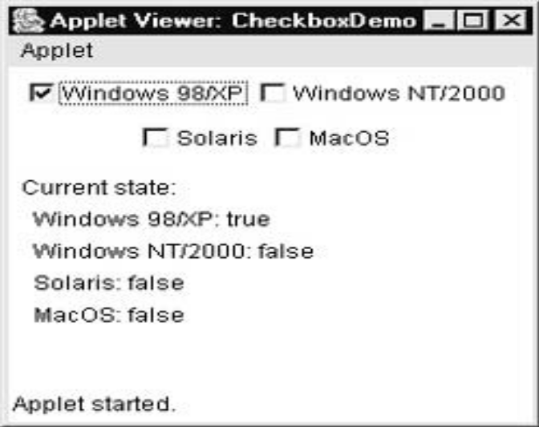
CheckboxExample
g.drawString(msg, 6, 100);
msg = " Windows NT: " + winNT.getState();
g.drawString(msg, 6, 120);
msg = " Solaris: " + solaris.getState();
g.drawString(msg, 6, 140);
msg = " MacOS: " + mac.getState();
g.drawString(msg, 6, 160);
}
}

Slide 36
Radio Buttons(checkboxgroup)
Radio buttons occur in groups. (mutually exclusive check boxes)
At most one radio button in a group can be checked at any given time.
A radio button is an object of type Checkbox that is a member of such a group.
An entire group of radio buttons is represented by an object belonging to the class CheckboxGroup.
You can determine which check box in a group is currently selected by calling getSelectedCheckbox( ).

Slide 37
Example: Radio Button
To create a group of radio buttons, you should first create an object of type CheckboxGroup
CheckboxGroup colorGroup = new CheckboxGroup();
Checkbox red = new Checkbox("Red", colorGroup, false);
Checkbox blue = new Checkbox("Blue", colorGroup, false);
Checkbox green = new Checkbox("Green", colorGroup, true);
Checkbox black = new Checkbox("Black", colorGroup,false);

Slide 38
Example Radiobutton
public class CBGroup extends Applet implements ItemListener {
String msg = "";
Checkbox Win98, winNT, solaris, mac;
CheckboxGroup cbg;
public void init() {
cbg = new CheckboxGroup();
Win98 = new Checkbox("Windows 98", cbg, true);
winNT = new Checkbox("Windows NT", cbg, false);
solaris = new Checkbox("Solaris", cbg, false);
mac = new Checkbox("MacOS", cbg, false);
add(Win98);
add(winNT);
add(solaris);
add(mac);

Slide 39
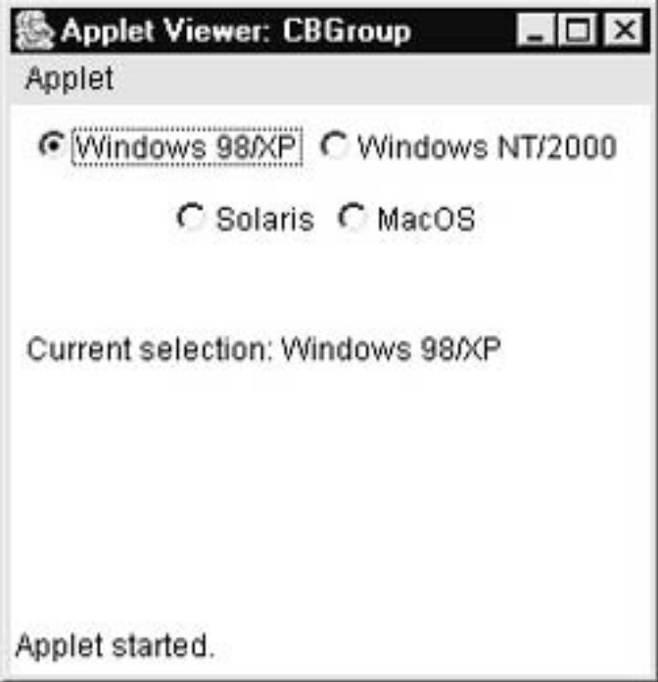
Win98.addItemListener(this);
winNT.addItemListener(this);
solaris.addItemListener(this);
mac.addItemListener(this);
}
public void itemStateChanged(ItemEvent ie) {
repaint();
}
// Display current state of the check boxes.
public void paint(Graphics g) {
msg = "Current selection: ";
msg += cbg.getSelectedCheckbox().getLabel();
g.drawString(msg, 6, 100);
}
}

Slide 40
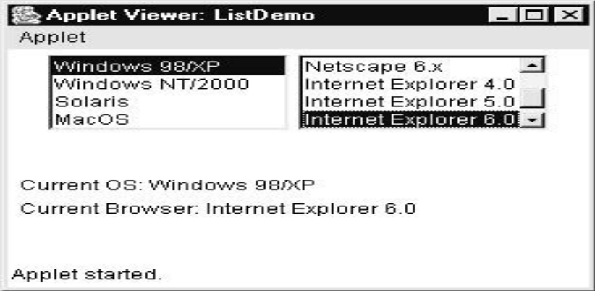
List
Compact multiple choice list.Displays all choices.
ActionEvent
constructors
  List( )
  List(int numRows)
  List(int numRows, boolean multipleSelect)

Slide 41
List methods
add(String): Adds the specified item to the end of scrolling list.
add(String,int): Adds the specified item to the scrolling list at the position indicated by the index.
getItemCount(): Gets the number of items in the list.
getItem(int index): Gets the item associated with the specified index.
getItems(): Returns a string array containing items of the list.
remove(int): Remove the item at the specified position from the scrolling list.
remove(String): Removes the first occurrence of an item from the list.

Slide 42
List methods (continued..)
removeAll(): Removes all items from the list.
Int getSelectedIndex(): Returns the index of the selected item, or -1 if no item is selected, or if more that one item is selected.
Int [] getSelectedIndexes(): Returns an array of the selected indexes of this scrolling list. If no items are selected, a zero-length array is returned.
String getSelectedItem(): Returns the selected item on the list, or null if no item is selected.
String [] getSelectedItems(): Returns the selected item on the list, or null if no item is selected.

Slide 43
ListDemo
public class ListDemo extends Applet implements ActionListener {
List os, browser;
String msg = "";
public void init() {
os = new List(4, true);
browser = new List(4, false);
// add items to os list
os.add("Windows 98");
os.add("Windows NT");
os.add("Solaris");

Slide 44
ListDemo
os.add("MacOS");
// add items to browser list
browser.add("Netscape 1.1");
browser.add("Netscape 2.x");
browser.add("Netscape 3.x");
browser.add("Netscape 4.x");
browser.add("Internet Explorer 2.0");
browser.add("Internet Explorer 3.0");
browser.add("Internet Explorer 4.0");
browser.add("Lynx 2.4");
browser.select(1);

Slide 45
ListDemo
// add lists to window
add(os);
add(browser);
// register to receive action events
os.addActionListener(this);
browser.addActionListener(this);
}
public void actionPerformed(ActionEvent ae) {
repaint();
}
// Display current selections.

Slide 46
ListDemo
public void paint(Graphics g) {
int idx[];
msg = "Current OS: ";
idx = os.getSelectedIndexes();
for(int i=0; i<idx.length; i++)
msg += os.getItem(idx[i]) + " ";
g.drawString(msg, 6, 120);
msg = "Current Browser: ";
msg += browser.getSelectedItem();
g.drawString(msg, 6, 140);
}
}

Slide 47
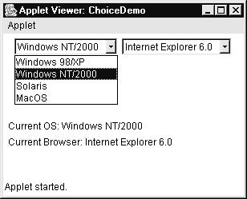
Choice
Creates popup list of items from which the user can choose.
Generates ItemEvent
It displays only item in selection unlike list where whole list is displayed.
Choice()//constructor
void add(String s)
To determine which item is selected call String getSelectedItem(),int getSelectedIndex()
Methods
Int getItemCount()
void select(int)
void select(String)
String getItem(int index)

Slide 48
Choice Example
public class ChoiceDemo extends Applet implements ItemListener {
Choice os, browser;
String msg = "";
public void init() {
os = new Choice();
browser = new Choice();
// add items to os list
os.add("Windows 98");
os.add("Windows NT");
os.add("Solaris");

Slide 49
Choice Example
os.add("MacOS");
// add items to browser list
browser.add("Netscape 1.1");
browser.add("Netscape 2.x");
browser.add("Netscape 3.x");
browser.add("Netscape 4.x");
browser.add("Internet Explorer 2.0");
browser.add("Internet Explorer 3.0");
browser.add("Internet Explorer 4.0");
browser.add("Lynx 2.4");

Slide 50
Choice Example
browser.select("Netscape 4.x");
// add choice lists to window
add(os);
add(browser);
// register to receive item events
os.addItemListener(this);
browser.addItemListener(this);
}
public void itemStateChanged(ItemEvent ie) {
repaint();

Slide 51
Choice Example
}
// Display current selections.
public void paint(Graphics g) {
msg = "Current OS: ";
msg += os.getSelectedItem();
g.drawString(msg, 6, 120);
msg = "Current Browser: ";
msg += browser.getSelectedItem();
g.drawString(msg, 6, 140);
}
}

Slide 52
Class TextField
A TextField object is a text component that allows for the editing of a single line of text.
Keyevent, ActionEvent, TextEvent
There are three main constructors of the TextField Class
  TextField(int columns)
  Constructs a new empty text field with the specified number of columns.
  TextField(String text)
  Constructs a new text field initialized with the specified text.
  TextField(String text, int columns)
  Constructs a new text field initialized with the specified text to be displayed, and wide enough to hold the specified number of columns.

Slide 53
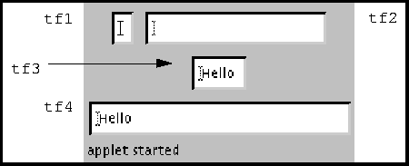
Example: TextField
TextField tf1, tf2, tf3, tf4;
tf1 = new TextField(); // a blank text field
tf2 = new TextField("", 20); // blank field of 20 columns
tf3 = new TextField("Hello!"); // predefined text displayed
tf4 = new TextField("Hello", 30); // predefined text in 30 columns

Slide 54
TextComponent methods
setText(String text): Sets the text that is presented by the text component to be the specified text.
getText(): Gets the text that is presented by the text component
select(int start, int end): Selects the text between the specified start and end positions. Characters in the range start <= pos < end are selected; characters are numbered starting from zero.
getSelectedText(): Returns the selected text of the text component.

Slide 55
TextComponent methods (continued…)
selectAll(): Selects all the text in the text component.
getSelectionStart(): Gets the start position of the selected text in the text component.
getSelectionEnd(): Gets the end position of the selected text in the text component.
void setEditable(boolean canEdit)
isEditable(): Returns true if the text component is editable; false otherwise.
void setEchoChar(char ch),char getEchoChar().

Slide 56
TextField Demo
public class TextFieldDemo extends Applet
implements ActionListener {
TextField name, pass;
public void init() {
Label namep = new Label("Name: ", Label.RIGHT);
Label passp = new Label("Password: ", Label.RIGHT);
name = new TextField(12);
pass = new TextField(8);
pass.setEchoChar('?');
add(namep);
add(name);
add(passp);
add(pass);
// register to receive action events

Slide 57
TextField Demo
name.addActionListener(this);
pass.addActionListener(this);
}
// User pressed Enter.
public void actionPerformed(ActionEvent ae) {
repaint();
}
public void paint(Graphics g) {
g.drawString("Name: " + name.getText(), 6, 60);
g.drawString("Selected text in name: "
+ name.getSelectedText(), 6, 80);
g.drawString("Password: " + pass.getText(), 6, 100);
}
}

Slide 58
Class TextArea
A TextArea object is a multi-line region that displays text. It can be set to allow editing or to be read-only.
A TextArea has four main constructors:
  TextArea(int rows, int columns)
  Constructs a new empty text area with the specified number of rows and columns.
  TextArea(String text)
  Constructs a new text area with the specified text.
  TextArea(String text, int rows, int columns)
  Constructs a new text area with the specified text, and with the specified number of rows and columns.
  TextArea(String text, int rows, int columns, int scrollbars)
  Constructs a new text area with the specified text, and with the rows, columns, and scroll bar visibility as specified.
  SCROLLBARS_BOTH SCROLLBARS_NONE
  SCROLLBARS_HORIZONTAL_ONLY SCROLLBARS_VERTICAL_ONLY

Slide 59
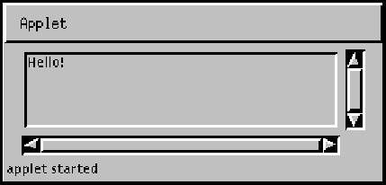
Example: TextArea

Slide 60
TextArea methods
The TextArea class adds a few useful procedures to those inherited from TextComponent:
append(String text): Adds the specified text at the end of the current contents; line breaks can be inserted by using the special character \n
insert(String text, int pos): Inserts the text, starting at specified position.
replaceRange(String text, int start, int end): Deletes the text from position start to position end and then insert the specified text in its place.

Slide 61
TextArea Example
public class TextAreaDemo extends Applet {
public void init() {
String val = "There are two ways of constructing " +
"a software design.\n" +
"One way is to make it so simple\n" +
"that there are obviously no deficiencies.\n" +
"And the other way is to make it so complicated\n" +
"that there are no obvious deficiencies.\n\n" +
" -C.A.R. Hoare\n\n" +

Slide 62
TextArea Example
"There's an old story about the person who wished\n" +
"his computer were as easy to use as his telephone.\n" +
"That wish has come true,\n" +
"since I no longer know how to use my telephone.\n\n" +
" -Bjarne Stroustrup, AT&T, (inventor of C++)";
TextArea text = new TextArea(val, 10, 30);
add(text);
}
}

Slide 63

ScrollBar
The Scrollbar class embodies a scroll bar.
Generates AdjustmentEvent
A scroll bar provides a convenient means for allowing a user to select from a range of values.
A Scrollbar class has two main constructors:
  Scrollbar(int orientation)
  Constructs a new scroll bar with the specified orientation.
  void setValues(int initialValue, int thumbSize, int min, int max)
  Scrollbar(int orientation, int value, int thumbsize, int minimum, int maximum)
  Constructs a new scroll bar with the specified orientation, initial value, page size, and minimum and maximum values.

Slide 64
Example: Scrollbar
redSlider=new Scrollbar(Scrollbar.VERTICAL, 0, 1, 0, 255);
add(redSlider);
blueSlider=new Scrollbar(Scrollbar.VERTICAL, 0, 1, 0, 255);
add(blueSlider);.
greenSlider=new Scrollbar(Scrollbar.VERTICAL, 0, 1, 0, 255);
add(greenSlider);
Methods:
int getValue( )
void setValue(int newValue)
int getMinimum( )
int getMaximum( )
void setUnitIncrement(int newIncr)
void setBlockIncrement(int newIncr)—for page up and page down

Slide 65
ScrollbarDemo
public class SBDemo extends Applet
implements AdjustmentListener, MouseMotionListener {
String msg = "";
Scrollbar vertSB, horzSB;
public void init() {
int width = Integer.parseInt(getParameter("width"));
int height = Integer.parseInt(getParameter("height"));
vertSB = new Scrollbar(Scrollbar.VERTICAL,
0, 1, 0, height);
horzSB = new Scrollbar(Scrollbar.HORIZONTAL, 0, 1, 0, width);

Slide 66
ScrollbarDemo
add(vertSB);
add(horzSB);
// register to receive adjustment events
vertSB.addAdjustmentListener(this);
horzSB.addAdjustmentListener(this);
addMouseMotionListener(this);
}
public void adjustmentValueChanged(AdjustmentEvent ae) {
repaint();
}

Slide 67
ScrollbarDemo
// Update scroll bars to reflect mouse dragging.
public void mouseDragged(MouseEvent me) {
int x = me.getX();
int y = me.getY();
vertSB.setValue(y);
horzSB.setValue(x);
repaint();
}
// Necessary for MouseMotionListener
public void mouseMoved(MouseEvent me) {
}

Slide 68
ScrollbarDemo
// Display current value of scroll bars.
public void paint(Graphics g) {
msg = "Vertical: " + vertSB.getValue();
msg += ", Horizontal: " + horzSB.getValue();
g.drawString(msg, 6, 160);
// show current mouse drag position
g.drawString("*", horzSB.getValue(),
vertSB.getValue());
}
}

Slide 69
Layout Managers
The components are laid out on a container using a layout manager.
The size and position of components are controlled by a layout manager.
There are several predefined layout manager classes in the AWT: FlowLayout, GridLayout, BorderLayout, CardLayout and GridBagLayout.
It is also possible to define new layout managers.
Every container is assigned a default layout manager when it is first created. For Window, the default layout manager is a BorderLayout for frame or window and FlowLayout for panel
A LayoutManager is a class which implements the LayoutManager interface.

Slide 70
LayoutManager
void setLayout(LayoutManager l)
Method of container is used to set/change default layout manager.
This method can also be used to disable default container layout object by passing null as parameter.If u do so then manually u should set the position of the components.

Slide 71
FlowLayout Manager
The components are arranged in the container from left to right in the order in which they were added. When one row becomes filled, a new row is started.
FlowLayout is the default Layout Manager for Applets and Panels.
FlowLayout()
  Constructs a new Flow Layout with a centered alignment and a default 5-unit horizontal and vertical gap.
FlowLayout(int how)
  Constructs a new Flow Layout with the specified alignment and a default 5-unit horizontal and vertical gap.
FlowLayout(int how, int horz, int vert)
  Creates a new flow layout manager with the indicated alignment and the indicated horizontal and vertical gaps.
LEFT,RIGHT,CENTER are the values passed as how
Ex: setLayout(new FlowLayout(FlowLayout.LEFT));

Slide 72
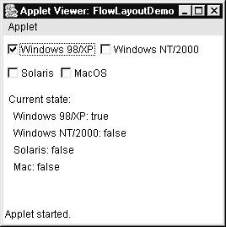

Slide 73
BorderLayout Manager
  A BorderLayout places one component in the center of a container. The central component is surrounded by up to four other components that border it to the "North", "South", "East", and "West",
  Each of the four bordering components is optional.
  The layout manager first allocates space to the bordering components. Any space that is left over goes to the center component.
  If a container uses a BorderLayout, then components should be added to the container using a version of the add() method that has two parameters.
  add(Component c, Object region)
  Ex: add(new Button(“button1"), BorderLayout.NORTH);

Slide 74
BorderLayout
BorderLayout()
  Constructs a new border layout with no gaps between components.
BorderLayout(int horz, int vertz)
  Constructs a border layout with the specified gaps between components.

Slide 75
BorderLayoutDemo
import java.awt.*;
import java.applet.*;
import java.util.*;
/*
<applet code="BorderLayoutDemo" width=400 height=200>
</applet>
*/
public class BorderLayoutDemo extends Applet {
public void init() {
setLayout(new BorderLayout());
add(new Button("This is across the top."), BorderLayout.NORTH);
add(new Label("The footer message might go here."), BorderLayout.SOUTH);
add(new Button("Right"), BorderLayout.EAST);
add(new Button("Left"), BorderLayout.WEST);

Slide 76
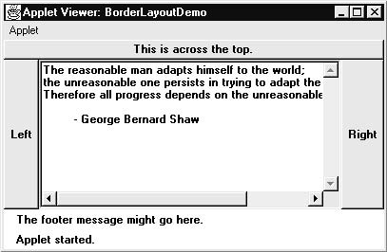
BorderLayoutDemo
String msg = "The reasonable man adapts " +
"himself to the world;\n" +
"the unreasonable one persists in " +
"trying to adapt the world to himself.\n" +
"Therefore all progress depends " +
"on the unreasonable man.\n\n" +
" - George Bernard Shaw\n\n";
add(new TextArea(msg), BorderLayout.CENTER);
}
}

Slide 77
Using Insets
Sometimes you want leave a small place between container that holds your component and the window that contains it.
Override the getInsets method which has this general form
Insets(int top, int left, int bottom, int right)
top,left,bottom,right specify the amount of space between the container and its enclosing window

Slide 78
InsetsDemo
import java.awt.*;
import java.applet.*;
import java.util.*;
public class InsetsDemo extends Applet {
public void init() {
// set background color so insets can be easily seen
setBackground(Color.cyan);
setLayout(new BorderLayout());
add(new Button("This is across the top."),
BorderLayout.NORTH);
add(new Label("The footer message might go here."),
BorderLayout.SOUTH);

Slide 79
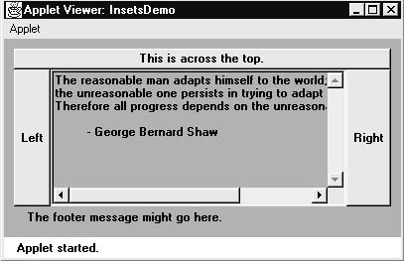
InsetsDemo
add(new Button("Right"), BorderLayout.EAST);
add(new Button("Left"), BorderLayout.WEST);
String msg = "The reasonable man adapts " +
"himself to the world;\n" +
"the unreasonable one persists in " +
"trying to adapt the world to himself.\n" +
"Therefore all progress depends " +
"on the unreasonable man.\n\n" +
" - George Bernard Shaw\n\n";
add(new TextArea(msg), BorderLayout.CENTER);
}
// add insets
public Insets getInsets() {
return new Insets(10, 10, 10, 10);
}
}

Slide 80
GridLayout Manager
  GridLayout arranges components into a grid of rows and columns.
  You can specify the number of rows and columns, or the number of rows only and let the layout manager determine the number of columns, or the number of columns only and let the layout manager determine the number of rows.
  The cells in the grid are equal size.
  GridLayout()
    Creates a grid layout with a default of one column per component, in a single row.
  GridLayout(int, int)
    Creates a grid layout with the specified number of rows and columns.
  GridLayout(int, int, int, int)
    Creates a grid layout with the specified number of rows and columns and space between rows and columns.

Slide 81
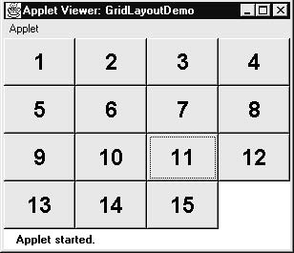
GridLayout
import java.awt.*;
import java.applet.Applet;
public class ButtonGrid extends Applet { public void init() {
setLayout(new GridLayout(3,2));
add(new Button("1"));
add(new Button("2"));
add(new Button(“ 3"));
add(new Button("4"));
add(new Button("5"));
add(new Button("6")); } }

Slide 82
CardLayout Manager
In a CardLayout only one of its components is visible at any given time.
Think of the components as a set of "cards". Only one card is visible at a time, but you can flip from one card to another.
Methods are provided in the CardLayout class for flipping to the first card, to the next card, and to the last card in the deck.
CardLayout()
  Creates a new card layout with gaps of size zero.
CardLayout(int, int)
  Creates a new card layout with the specified horizontal and vertical gaps.

Slide 83
CardLayout
Cards are held in objects of type Panel.
This Panel should be set to CardLayout.
This Panel will be called deck.
The individual cards in the deck are also objects of type Panel.
These panels should hold individual components and Layouts.
Then these are added to the main Panel (deck).
The deck is then added to the applet panel.

Slide 84
methods
CardLayout class member methods are:
  void add(Component panelObj, Object name)
  void first(Container deck)
  void last(Container deck)
  void next(Container deck)
  void previous(Container deck)
  void show(Container deck, String cardName)

Slide 85
CardLayoutDemo(2 cards)
import java.awt.*;
import java.awt.event.*;
import java.applet.*;
/*
<applet code="CardLayoutDemo" width=300 height=100>
</applet>
*/
public class CardLayoutDemo extends Applet
implements ActionListener, MouseListener {
Checkbox Win98, winNT, solaris, mac;
Button Win, Other;
public void init() {
Win = new Button("Windows");
Other = new Button("Other");
add(Win);
add(Other);

Slide 86
CardLayoutDemo
CardLayout cardLO = new CardLayout();
//create a main panel(deck)
Panel osCards = new Panel();
osCards.setLayout(cardLO); // set panel layout to card layout
//create components to be added to cards
Win98 = new Checkbox("Windows 98", null, true);
winNT = new Checkbox("Windows NT");
solaris = new Checkbox("Solaris");
mac = new Checkbox("MacOS");
// create a new window panel(card) add Windows check boxes to it
Panel winPan = new Panel();
winPan.add(Win98);
winPan.add(winNT);
// create a new other panel(card) add other check boxes to it
Panel otherPan = new Panel();
otherPan.add(solaris);
otherPan.add(mac);

Slide 87
CardLayoutDemo
// add window and other panels to card deck(main) panel
osCards.add(winPan, "Windows");
osCards.add(otherPan, "Other");
// add main panel to applet panel
add(osCards);
// register to receive action events
Win.addActionListener(this);
Other.addActionListener(this);
// register mouse events
addMouseListener(this);
}
// Cycle through panels.
public void mousePressed(MouseEvent me) {
cardLO.next(osCards);
}

Slide 88
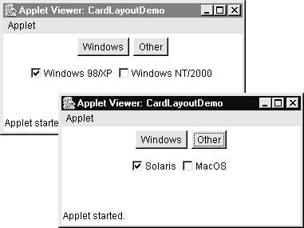
CardLayoutDemo
// Provide empty implementations for the other MouseListener methods.
public void mouseClicked(MouseEvent me) {
}
public void mouseEntered(MouseEvent me) {
}
public void mouseExited(MouseEvent me) {
}
public void mouseReleased(MouseEvent me) {
}
public void actionPerformed(ActionEvent ae) {
if(ae.getSource() == Win) {
cardLO.show(osCards, "Windows");
}
else {
cardLO.show(osCards, "Other");
}
}
}

Slide 89
Menu, MenuBar, MenuItem
A Menu object is a pull-down menu component that is deployed from a menu bar.
A menu can optionally be a tear-off menu. A tear-off menu can be opened and dragged away from its parent menu bar or menu. It remains on the screen after the mouse button has been released.
Each item in a menu must belong to the MenuItem class. It can be an instance of MenuItem, a submenu (an instance of Menu), or a check box (an instance of CheckboxMenuItem).
Anumita Jha

Slide 90
Menu, MenuBar, MenuItem
There are two main constructors for the Menu class:
  Menu(String label)
  Constructs a new menu with the specified label.
  Menu(String optionName, boolean removable)
Anumita Jha

Slide 91
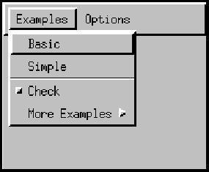
Menu, MenuBar, MenuItem
The MenuBar class encapsulates the platform's concept of a menu bar bound to a frame.
The MenuBar class has only one constructor:
MenuBar()
Anumita Jha

Slide 92
Menu, MenuBar, MenuItem
All items in a menu must belong to the class MenuItem, or one of its subclasses. There are five menu items in the pictures below. “basic”, Simple”, the – label, “Check”, “More Examples” which is the submenu of instance Menu
Anumita Jha

Slide 93
CheckboxMenuItem
This class represents a check box that can be included in a menu. Clicking on the check box in the menu changes its state from "on" to "off" or from "off" to "on.“
The item labeled Check shows a check box menu item in its "off" state.
Anumita Jha

Slide 94
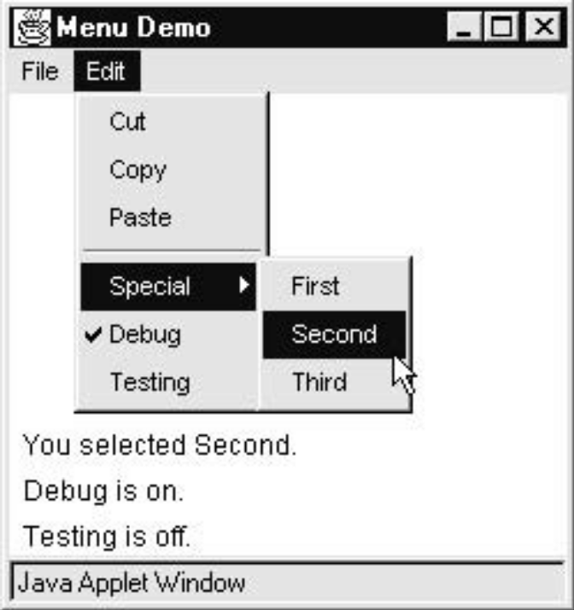
MenubarExample
class MenuFrame extends Frame {
String msg = "";
CheckboxMenuItem debug, test;
MenuFrame(String title) {
super(title);
// create menu bar and add it to frame
MenuBar mbar = new MenuBar();
setMenuBar(mbar);
Anumita Jha

Slide 95
MenubarExample
// create the menu and its menu items
Menu file = new Menu("File");
MenuItem item1, item2, item3, item4, item5;
file.add(item1 = new MenuItem("New..."));
file.add(item2 = new MenuItem("Open..."));
file.add(item3 = new MenuItem("Close"));
file.add(item4 = new MenuItem("-"));
file.add(item5 = new MenuItem("Quit..."));
mbar.add(file);
Anumita Jha

Slide 96
MenubarExample
Menu edit = new Menu("Edit");
MenuItem item6, item7, item8, item9;
edit.add(item6 = new MenuItem("Cut"));
edit.add(item7 = new MenuItem("Copy"));
edit.add(item8 = new MenuItem("Paste"));
edit.add(item9 = new MenuItem("-"));
// adding a sub menu in a menu
Menu sub = new Menu("Special");
MenuItem item10, item11, item12;
Anumita Jha

Slide 97
MenubarExample
sub.add(item10 = new MenuItem("First"));
sub.add(item11 = new MenuItem("Second"));
sub.add(item12 = new MenuItem("Third"));
edit.add(sub);
// these are checkable menu items
debug = new CheckboxMenuItem("Debug");
edit.add(debug);
test = new CheckboxMenuItem("Testing");
edit.add(test);
mbar.add(edit);
Anumita Jha

Slide 98
MenubarExample
// create an object to handle action and item events
MyMenuHandler handler = new MyMenuHandler();
// register it to receive those events
item1.addActionListener(handler);
item2.addActionListener(handler);
item3.addActionListener(handler);
item4.addActionListener(handler);
item5.addActionListener(handler);
item6.addActionListener(handler);
item7.addActionListener(handler);
item8.addActionListener(handler);
item9.addActionListener(handler);
item10.addActionListener(handler);
item11.addActionListener(handler);
item12.addActionListener(handler);
debug.addItemListener(handler);
test.addItemListener(handler);

Slide 99
MenubarExample
// create an object to handle window events
// register it to receive those events
addWindowListener(new MyWindowAdapter( ));
}
public void paint(Graphics g) {
g.drawString(msg, 10, 200);
if(debug.getState())
g.drawString("Debug is on.", 10, 220);
else
g.drawString("Debug is off.", 10, 220);
if(test.getState())
g.drawString("Testing is on.", 10, 240);
else
g.drawString("Testing is off.", 10, 240);
}
class MyWindowAdapter extends WindowAdapter {
public void windowClosing(WindowEvent we) {
this.setVisible(false);
}
}

Slide 100
MenubarExample
class MyMenuHandler implements ActionListener, ItemListener {
// Handle action events
public void actionPerformed(ActionEvent ae) {
  String msg = "You selected ";
  String arg = (String)ae.getActionCommand();
  if(arg.equals("New..."))
  msg += "New.";
  else if(arg.equals("Open..."))
  msg += "Open.";
  else if(arg.equals("Close"))
  msg += "Close.";
  else if(arg.equals("Quit..."))
  msg += "Quit.";
  else if(arg.equals("Edit"))
  msg += "Edit.";
  else if(arg.equals("Cut"))
  msg += "Cut.";
  else if(arg.equals("Copy"))
  msg += "Copy.";
  else if(arg.equals("Paste"))
  msg += "Paste.";
  else if(arg.equals("First"))

Slide 101
MenubarExample
msg += "First.";
else if(arg.equals("Second"))
msg += "Second.";
else if(arg.equals("Third"))
msg += "Third.";
else if(arg.equals("Debug"))
msg += "Debug.";
else if(arg.equals("Testing"))
msg += "Testing.";
repaint();
}
// Handle item events
public void itemStateChanged(ItemEvent ie) {
repaint();
}
}

Slide 102
MenubarExample
// Create frame window.
public class MenuDemo extends Applet {
Frame f;
public void init() {
f = new MenuFrame("Menu Demo");
int width = Integer.parseInt(getParameter("width"));
int height = Integer.parseInt(getParameter("height"));
setSize(new Dimension(width, height));
f.setSize(width, height);
f.setVisible(true);
}
public void start() {
f.setVisible(true);
}
public void stop() {
f.setVisible(false);
}
}

Slide 103
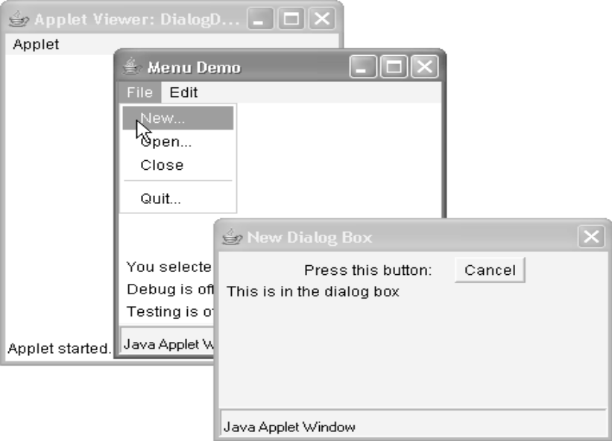
Dialog
A Dialog is a top-level window with a title and a border that is typically used to take some form of input from the user.
The default layout for a Dialog is BorderLayout.
A Dialog must have either a frame or another dialog defined as its owner when it's constructed.
When the owner window of a visible dialog is hidden or minimized, the dialog will automatically be hidden from the user. When the owner window is subsequently re-opened, then the dialog is made visible to the user again.
constructors
Dialog(Frame parentWindow, boolean mode)
Dialog(Frame parentWindow, String title, boolean mode)

Slide 104
Dialog
A dialog can be either modeless (the default) or modal.
When a modal dialog is created, its parent frame is blocked.
A Dialog cannot have a menu bar, but it can contain other GUI components.
Look at the API for Dialog constructor and methods.
You can use override the Dialog box to create your own dialog box.

Slide 105
class HandlingDemo{
Frame f=new Frame();
HandlingDemo(){
f.setLayout( new FlowLayout() ); f.setVisible(true);
but1=new Button("button1"); but2=new Button("button2");
f.add(but1); f.add(but2);
actionhandler handle=new actionhandler();
but1.addActionListener(handle);
}
class actionhandler implements ActionListener{
Dialog d;
public void actionPerformed( ActionEvent ae)
{
if(ae.getSource()== but1)
d=new Dialog(f," but1 pressed“, true);
if(ae.getSource()== but2)
d=new Dialog(f," but2 pressed“, true);
d.setSize(100,100);
d.setVisible(true);
}
}

Slide 106
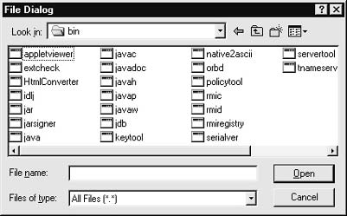
FileDialog
The FileDialog class displays a dialog window from which the user can select a file.
The FileDialog is a modal dialog, it blocks the rest of the application until the user has chosen a file.
constructors
FileDialog(Frame parent, String boxName)
FileDialog(Frame parent, String boxName, int how)
FileDialog(Frame parent)
If how isFileDialog.LOAD, then the box is selecting a file for reading. If how is FileDialog.SAVE,
the box is selecting a file for writing.

Slide 107
example
class FileDialogDemo {
public static void main(String args[]) {
Frame f = new SampleFrame("File Dialog Demo");
f.setVisible(true);
f.setSize(100, 100);
FileDialog fd = new FileDialog(f, "File Dialog");
fd.setVisible(true);
}
}

Slide 108
Swing
In Java 1.2 Sun Microsystems introduced a new set of GUI components called "Swing."
Swing consists of a collection of classes defined in the package javax.swing.
Swing builds on the basic functionality of the AWT.
For each type of GUI component in the AWT, there is a corresponding class in Swing.
Response to deficiencies in AWT

Slide 109
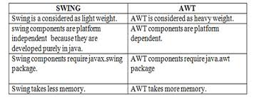
AWT vs Swing
Anumita Jha

Slide 110
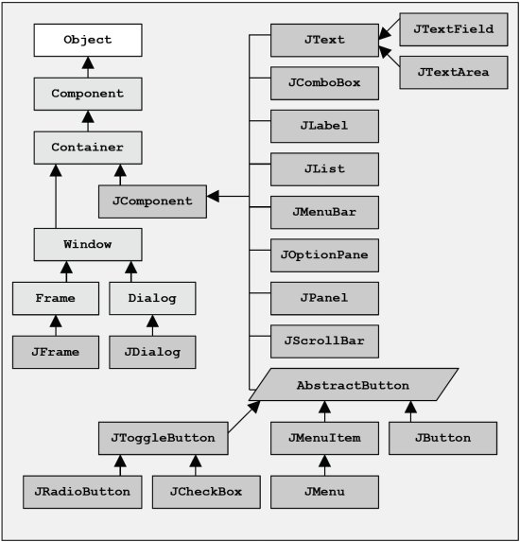
Swing Classes Hierarchy
Anumita Jha

Slide 111
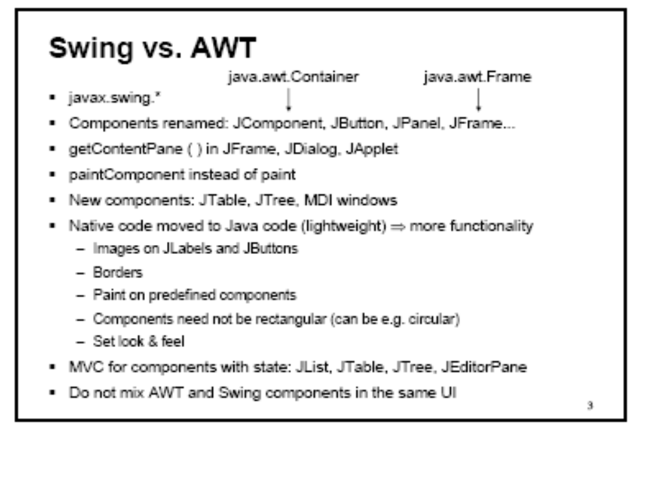
Anumita Jha

Slide 112
Swing Vs AWT
Swing has customizable look and feel
Swings are Lighweight controls
Swings provide advanced and additional components
Majority of classes written in java and hence platform independent.
Support for MVC architecture(pluggable look &feel)
New look and feel as default.
All class names start with J and uses paintComponent instead of paint

Slide 113
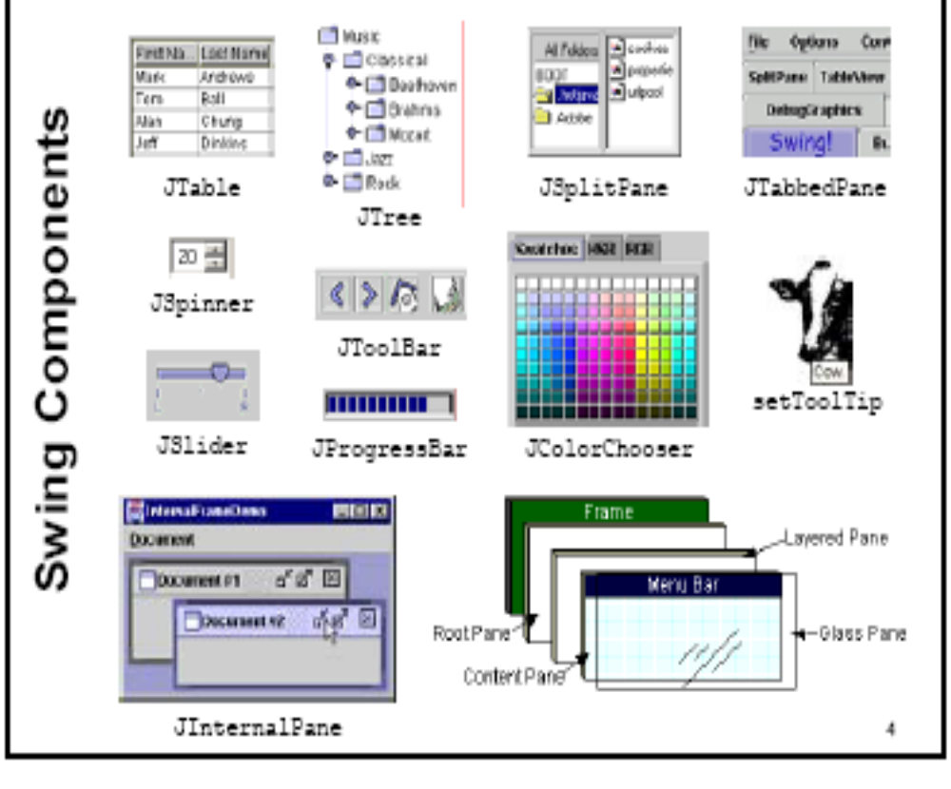
Anumita Jha

Slide 114
JApplet
rich with functionality
supports various “panes,” such as the content pane, the glass pane, and the root pane.
call add( ) for the content pane of the Japplet object.(prior to jdk 5)
  Container getContentPane( )
  Ex: jfrm.getContentPane().add(jlab); //(old style)
Anumita Jha

Slide 115
JApplet with Label
import java.awt.*;
import javax.swing.*;
/*<applet code="JLabelDemo" width=250 height=150>
</applet>
*/
public class JLabelDemo extends JApplet {
public void init() {
// Create an icon
ImageIcon ii = new ImageIcon("france.gif");
// Create a label
JLabel jl = new JLabel("France", ii, JLabel.CENTER);
// Add label to the content pane
add(jl);
}}
Anumita Jha

Slide 116
JApplet contd…
import javax.swing.*;
import java.awt.*;
import java.awt.event.*;
public class MySwingApplet extends JApplet {
JButton jbtnAlpha; JButton jbtnBeta; JLabel jlab;
// Initialize the applet.
public void init() {
try {
SwingUtilities.invokeAndWait(new Runnable () {
public void run() {
makeGUI(); // initialize the GUI
}
});
} catch(Exception exc) {
System.out.println("Can't create because of "+ exc);
}
}
Anumita Jha
Notes:
All swing GUI components are created and updated from event dispatching thread, and not the main thread
Main is executed from the main thread
Main cannot directly instantiate a class object, it must create a Runnable object that executes on the event dispatching thread and have this object create the GUI

Slide 117
private void makeGUI() {
  setLayout(new FlowLayout());
  jbtnAlpha = new JButton("Alpha"); jbtnBeta = new JButton("Beta");
  // Add action listener for Alpha( anonymous inner class)
  jbtnAlpha.addActionListener(new ActionListener() {
  public void actionPerformed(ActionEvent le) {
  jlab.setText("Alpha was pressed.");
  }});
  // Add action listener for Beta( anonymous inner class)
  jbtnBeta.addActionListener(new ActionListener() {
  public void actionPerformed(ActionEvent le) {
  jlab.setText("Beta was pressed.");
  }});
  // Add the buttons to the content pane.
  add(jbtnAlpha); add(jbtnBeta);
  // Create a text-based label.
  jlab = new JLabel("Press a button.");
  // Add the label to the content pane.
  add(jlab);
}}
Anumita Jha

Slide 118
Swing application
import java.awt.*;
import java.awt.event.*;
import javax.swing.*;
class EventDemo {
JLabel jlab;
EventDemo() {
// Create a new JFrame container.
JFrame jfrm = new JFrame("An Event Example");
// Specify FlowLayout for the layout manager.
jfrm.setLayout(new FlowLayout());
// Give the frame an initial size.
jfrm.setSize(220, 90);
// Terminate the program when the user closes the application.
jfrm.setDefaultCloseOperation(JFrame.EXIT_ON_CLOSE);
Anumita Jha

Slide 119
// Make two buttons.
JButton jbtnAlpha = new JButton("Alpha");
JButton jbtnBeta = new JButton("Beta");
// Add action listener for Alpha.
jbtnAlpha.addActionListener(new ActionListener() {
public void actionPerformed(ActionEvent ae) {
jlab.setText("Alpha was pressed.");
}
});
// Add action listener for Beta.
jbtnBeta.addActionListener(new ActionListener() {
public void actionPerformed(ActionEvent ae) {
jlab.setText("Beta was pressed.");
}
});
Anumita Jha

Slide 120
// Add the buttons to the content pane.
jfrm.add(jbtnAlpha);
jfrm.add(jbtnBeta);
// Create a text-based label.
jlab = new JLabel("Press a button.");
// Add the label to the content pane.
jfrm.add(jlab);
// Display the frame.
jfrm.setVisible(true);
}
public static void main(String args[]) {
// Create the frame on the event dispatching thread.
SwingUtilities.invokeLater(new Runnable() {
public void run() {
new EventDemo();
}
});
}}
Anumita Jha

Slide 121
Ref.Text Book for the following class constructors and some frequently used member methods
JTextField
JLabel
JButton
ImageIcon
JCheckBox
JRadioButton
JComboBox
JTabbedPane
JScrollPane
JTree
JTable
Examples as explained in book are to be refered mainly from
Chapter 26 of complete reference.

Slide 122
JLabel
JLabel(Icon icon)
JLabel(String str)
JLabel(String str, Icon icon, int align)
private void makeGUI() {
// Create an icon.
ImageIcon ii = new ImageIcon(“c:\pic\france.gif");
// Create a label.
JLabel jl = new JLabel("France", ii, JLabel.CENTER);
// Add the label to the content pane.
add(jl);
}
}

Slide 123
JTextfield
private void makeGUI() {
// Change to flow layout.
setLayout(new FlowLayout());
// Add text field to content pane.
jtf = new JTextField(15);
add(jtf);
jtf.addActionListener(new ActionListener() {
public void actionPerformed(ActionEvent ae) {
// Show text when user presses ENTER.
showStatus(jtf.getText());
}
});
}
}

Slide 124
Jbutton
private void makeGUI() {
// Change to flow layout.
setLayout(new FlowLayout());
// Add buttons to content pane.
ImageIcon france = new ImageIcon("france.gif");
JButton jb = new JButton(france);
jb.setActionCommand("France");
jb.addActionListener(this);
add(jb);
jlab = new JLabel("Select languages");
add(jlab);
}
public void actionPerformed(ActionEvent ae) {
jlab.setText("You selected " + ae.getActionCommand());
}
}

Slide 125
JCheckbox
private void makeGUI() {
// Change to flow layout.
setLayout(new FlowLayout());
// Add check boxes to the content pane.
JCheckBox cb = new JCheckBox("C");
cb.addItemListener(this);
add(cb);
jlab = new JLabel("Select languages");
add(jlab);
}
// Handle item events for the check boxes.
public void itemStateChanged(ItemEvent ie) {
JCheckBox cb = (JCheckBox)ie.getItem();
if(cb.isSelected())
jlab.setText(cb.getText() + " is selected");
else
jlab.setText(cb.getText() + " is cleared");
}
}

Slide 126
JRadiobutton
private void makeGUI() {
// Change to flow layout.
setLayout(new FlowLayout());
jlab = new JLabel("Select One");
add(jlab);
}
// Create radio buttons and add them to content pane.
JRadioButton b1 = new JRadioButton("A");
b1.addActionListener(this);
add(b1);
ButtonGroup bg = new ButtonGroup();
bg.add(b1);
// Handle button selection.
public void actionPerformed(ActionEvent ae) {
jlab.setText("You selected " + ae.getActionCommand());
}
}

Slide 127
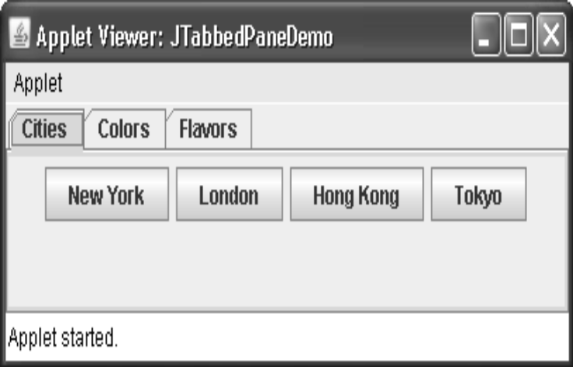
Jtabbed pane
private void makeGUI() {
JTabbedPane jtp = new JTabbedPane();
jtp.addTab("Cities", new CitiesPanel());
jtp.addTab("Colors", new ColorsPanel());
jtp.addTab("Flavors", new FlavorsPanel());
add(jtp);
}}
class CitiesPanel extends JPanel {
public CitiesPanel() {
JButton b1 = new JButton("New York");
add(b1);
JButton b2 = new JButton("London");
add(b2);
JButton b3 = new JButton("Hong Kong");
add(b3);
JButton b4 = new JButton("Tokyo");
add(b4);}}

Slide 128
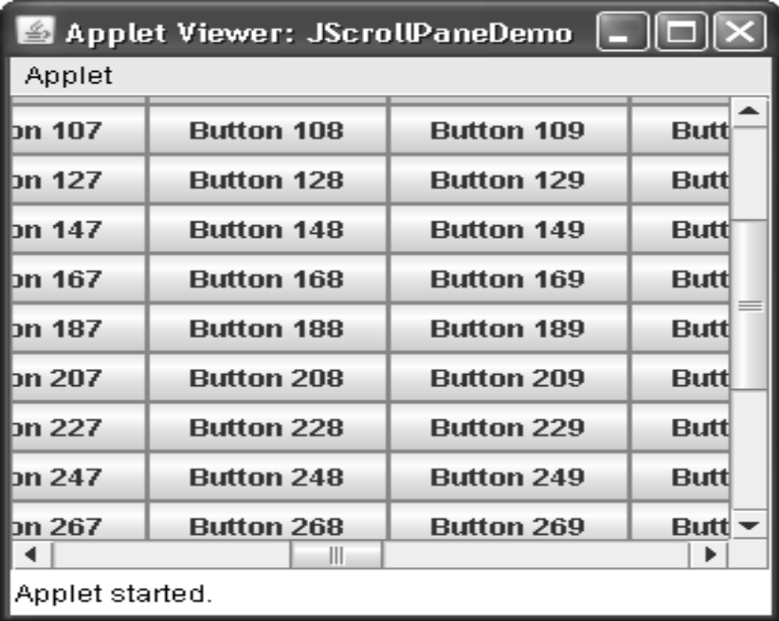
JScrollpane
private void makeGUI() {
// Add 400 buttons to a panel.
JPanel jp = new JPanel();
jp.setLayout(new GridLayout(20, 20));
int b = 0;
for(int i = 0; i < 20; i++) {
for(int j = 0; j < 20; j++) {
jp.add(new JButton("Button " + b));
++b;
}}
// Create the scroll pane.
JScrollPane jsp = new JScrollPane(jp);
add(jsp, BorderLayout.CENTER);
}}

Slide 129
JList
String Cities[] = { "New York", "Chicago", "Houston",
"Denver", "Los Angeles", "Seattle",
"London", "Paris", "New Delhi",
"Hong Kong", "Tokyo", "Sydney“
};
JList jlst = new JList(Cities);
// Set the list selection mode to single selection.
jlst.setSelectionMode(ListSelectionModel.SINGLE_SELECTION);
Anumita Jha

Slide 130
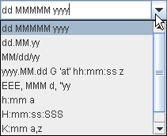
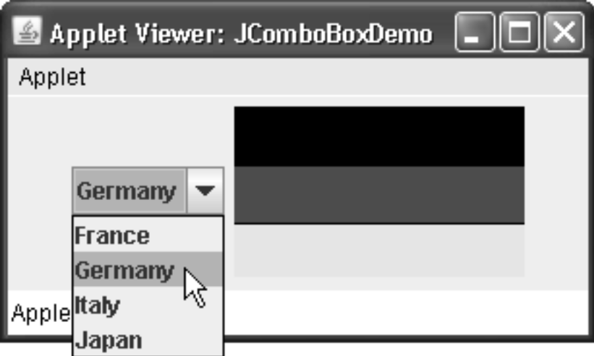
JCombobox
String flags[] = { "France", "Germany", "Italy", "Japan" };
JComboBox jcb = new JComboBox(flags);
add(jcb);
…..
jcb.addActionListener(new ActionListener() {
public void actionPerformed(ActionEvent ae) {
String s = (String) jcb.getSelectedItem();
jlab.setIcon(new ImageIcon(s + ".gif"));
}
});

Slide 131
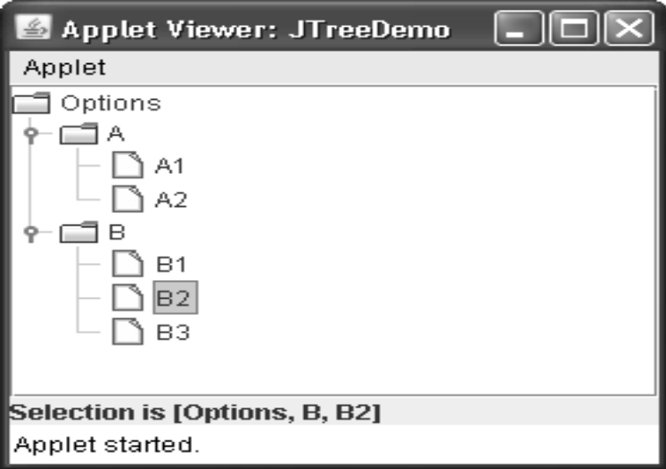
JTree
JTree tree;
JLabel jlab;
…………..
private void makeGUI() {
// Create top node of tree.
DefaultMutableTreeNode top = new DefaultMutableTreeNode("Options");
// Create subtree of "A".
DefaultMutableTreeNode a = new DefaultMutableTreeNode("A");
top.add(a);
DefaultMutableTreeNode a1 = new DefaultMutableTreeNode("A1");
a.add(a1);
DefaultMutableTreeNode a2 = new DefaultMutableTreeNode("A2");
a.add(a2);
Anumita Jha

Slide 132
// Create subtree of "B".
DefaultMutableTreeNode b = new DefaultMutableTreeNode("B");
top.add(b);
DefaultMutableTreeNode b1 = new DefaultMutableTreeNode("B1");
b.add(b1);
DefaultMutableTreeNode b2 = new DefaultMutableTreeNode("B2");
b.add(b2);
DefaultMutableTreeNode b3 = new DefaultMutableTreeNode("B3");
b.add(b3);
// Create the tree.
JTree tree = new JTree(top);
Anumita Jha

Slide 133
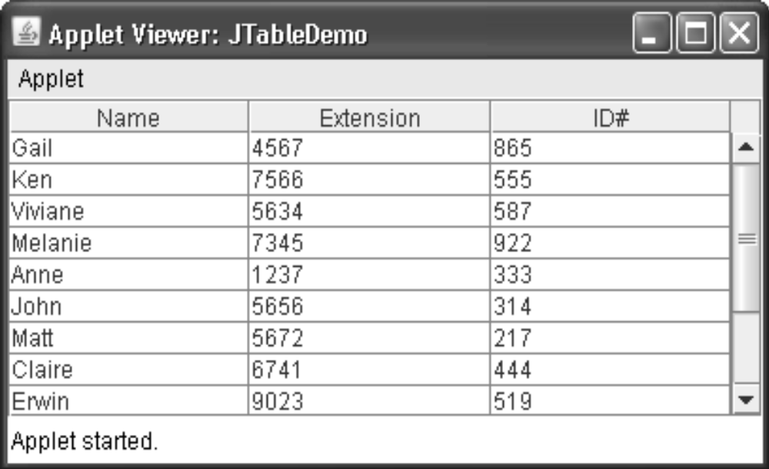
JTable
private void makeGUI() {
// Initialize column headings.
String[] colHeads = { "Name", "Extension", "ID#" };
String [ ][ ] data = {
{ "Gail", "4567", "865" },
{ "Ken", "7566", "555" },
{ "Viviane", "5634", "587" },
{ "Melanie", "7345", "922" },
{ "Anne", "1237", "333" },
{ "John", "5656", "314" },
{ "Matt", "5672", "217" },
{ "Claire", "6741", "444" },
{ "Erwin", "9023", "519" },
{ "Ellen", "1134", "532" },
{ "Jennifer", "5689", "112" },
{ "Ed", "9030", "133" },
{ "Helen", "6751", "145" }
};
JTable table = new JTable(data, colHeads);

